Slide 1
Orange Education
Orange Education is an IT Education company Offering Computer Textbooks for K12 We have 45+ titles with latest topics that are trending and suggested by boards like CBSE, ICSE, SSC etc.

Slide 2
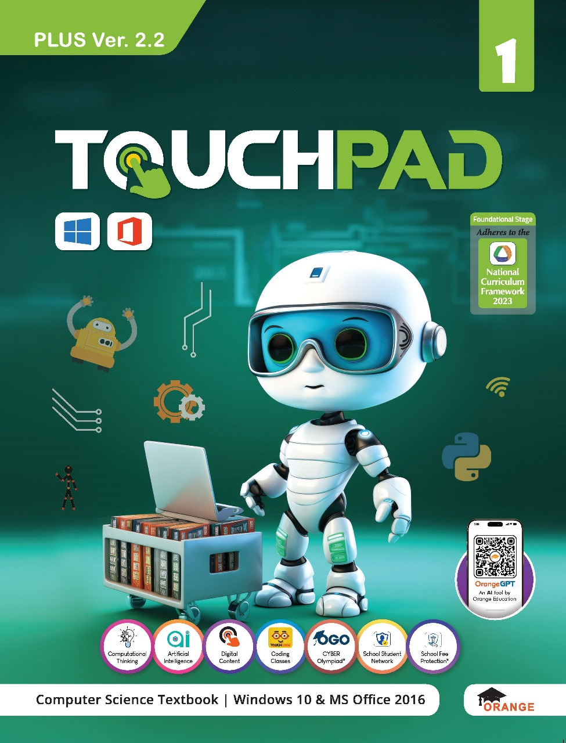
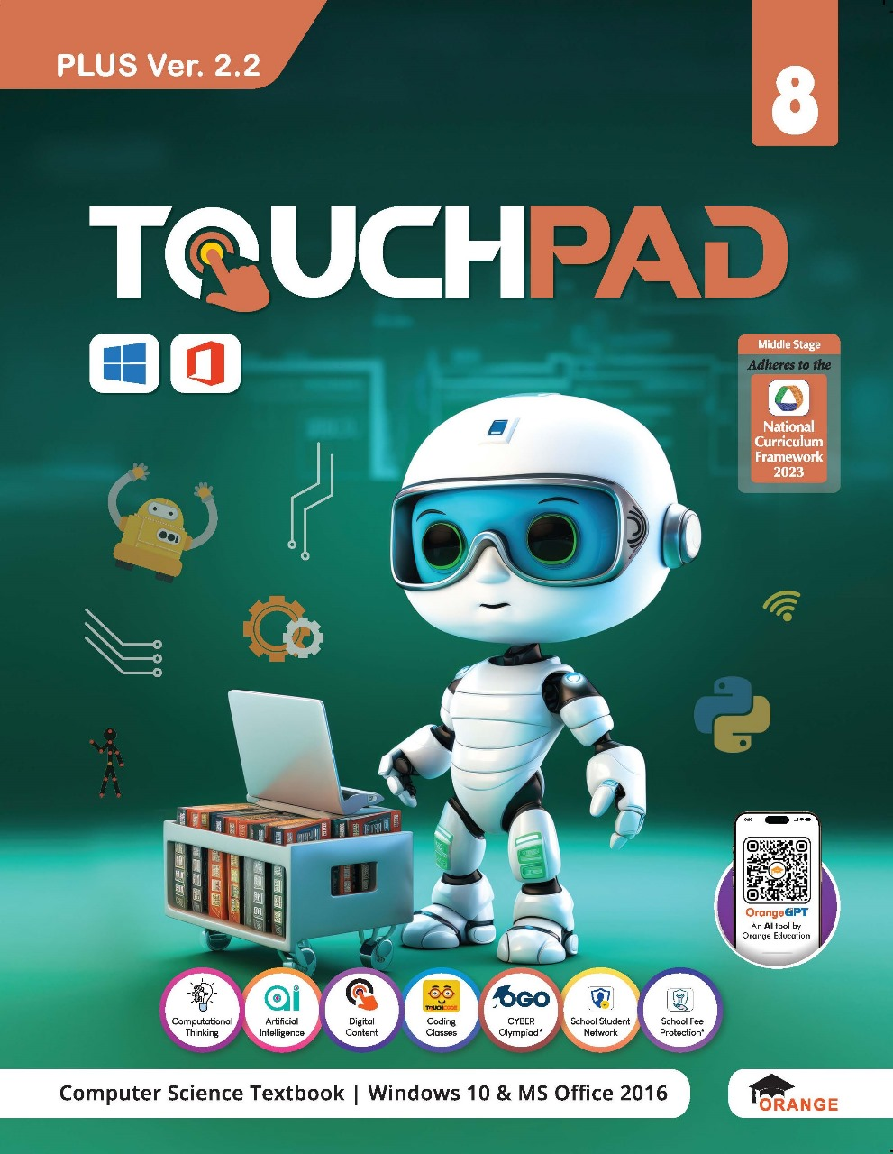
Touchpad Plus V2.2 Windows 10 & Office 16

Slide 3

Touchpad Plus V2.2
For Grades 1-8
Content Matrix
Main Topics
Computational Thinking (I-VIII)
Artificial Intelligence (I-VIII)
Paint (I-II)
Tux Paint (I-II)
Pivot Animator (III)
ScratchJr. (I-II)
Scratch 3.0 (III-V)
Adobe Animate CC (VI-VII)
HTML5, CSS3 (VI-VIII)
Python (VI-VIII)
App Development (VII)
Google Apps (VIII)
Adobe Photoshop CC (VIII)
Supplements
Latest IT Trends (VI)
Microsoft Office 365 (VII)
Office 365 (VIII)
Note: As Skype has been discontinued, it is replaced by Microsoft Teams.

Slide 4
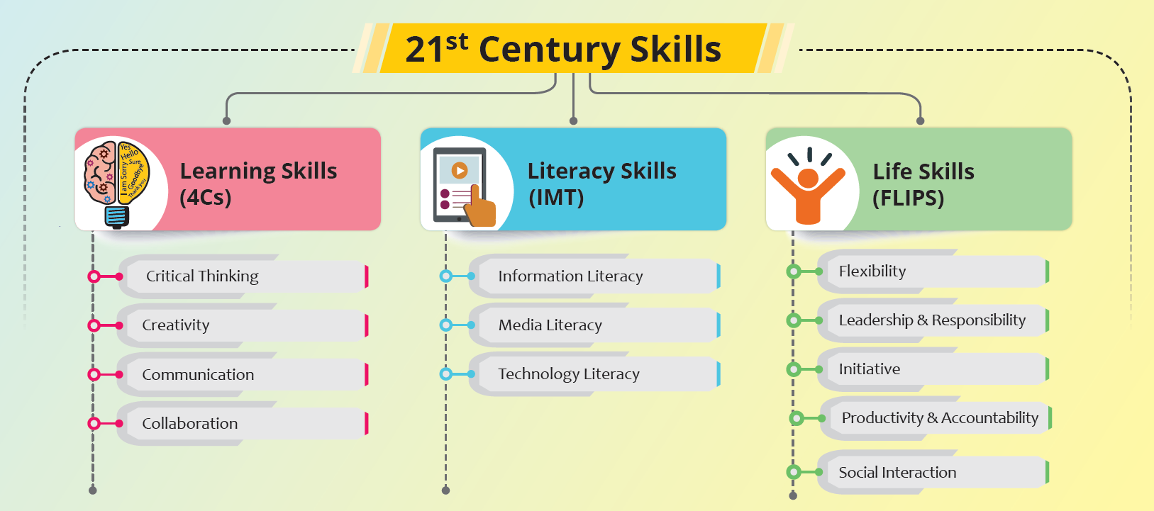
Aligned with NCF 2023

Slide 5
For Grades 1to 12
Aligned with NCF 2023
For Grade 1-8
Panchpadi - 5 Steps Learning Process
Aditi (Introduction)
Bodh (Conceptual Understanding)
Abhyas (Practice)
Prayas (Application)
Prasar (Expansion)

Slide 6
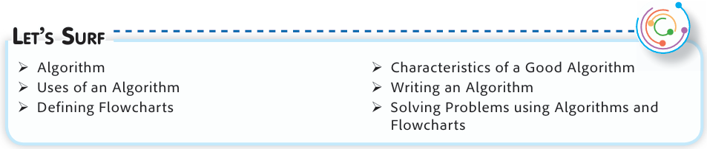
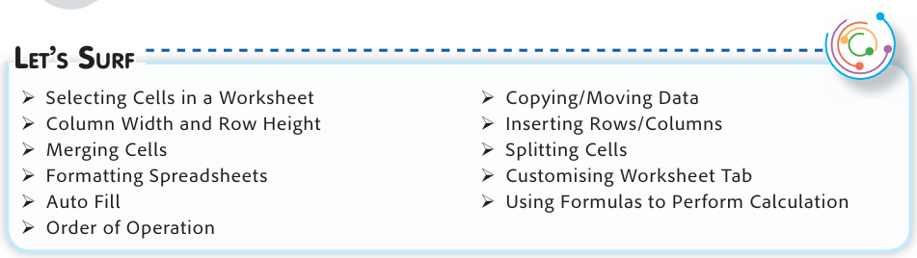
Aligned with NCF 2023
Aditi (Introduction)

Slide 7
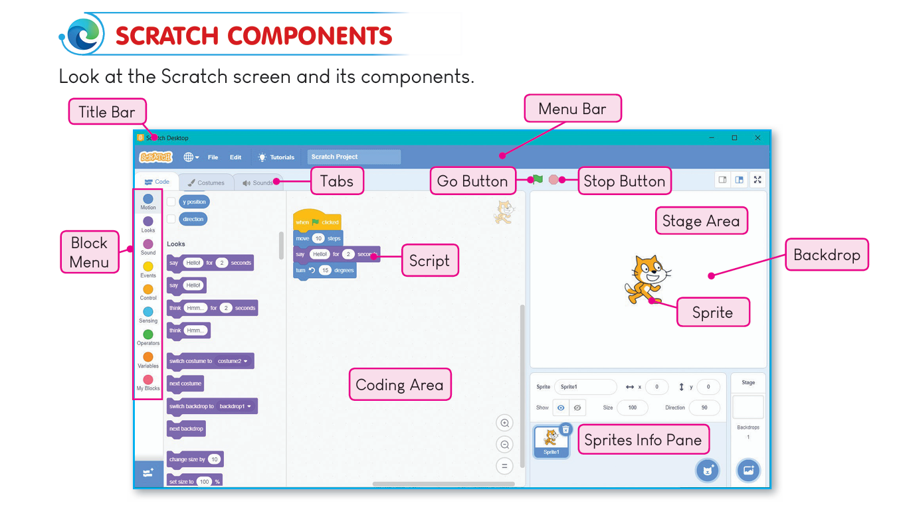
Aligned with NCF 2023
Bodh (Conceptual Understanding)

Slide 8
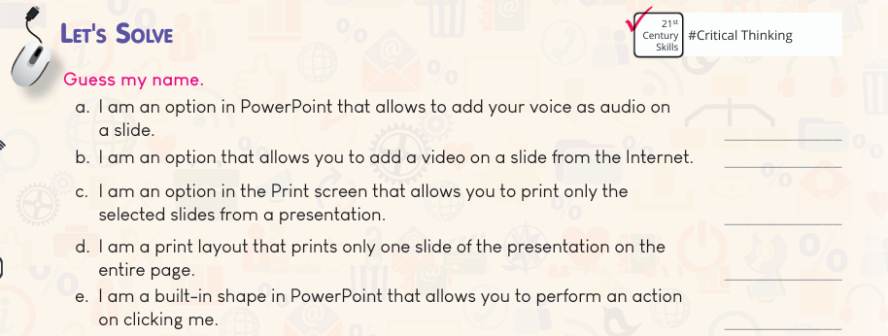
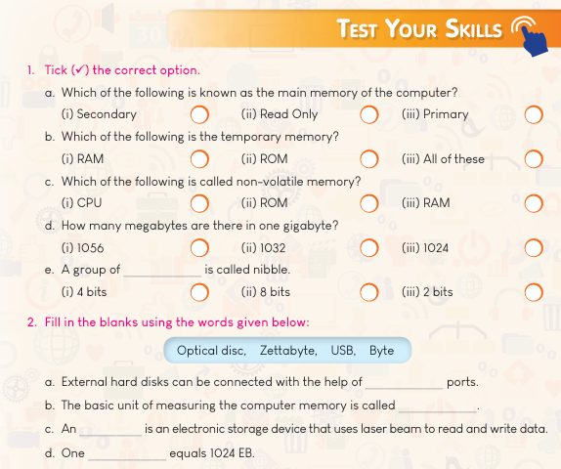
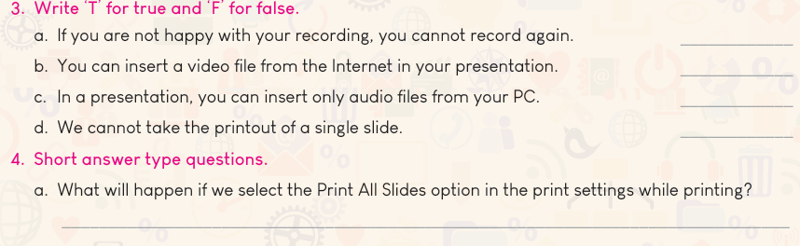
Aligned with NEP 2020 & NCF-SE 2023
Abhyas (Practice)

Slide 9
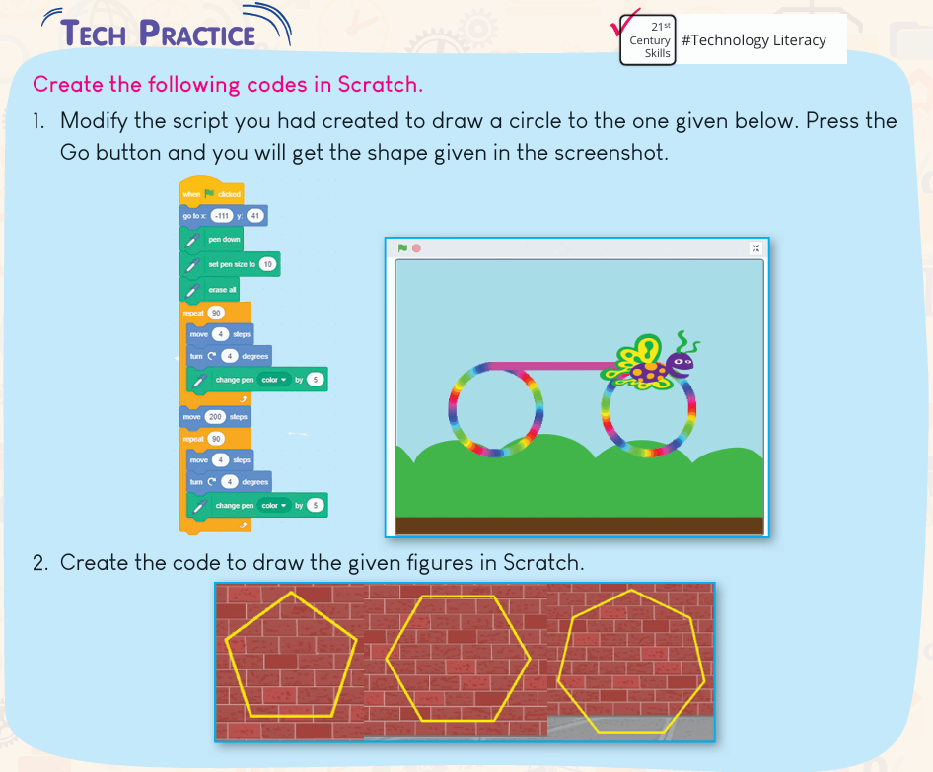
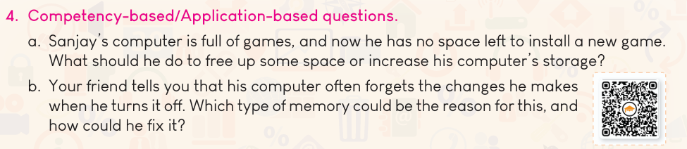
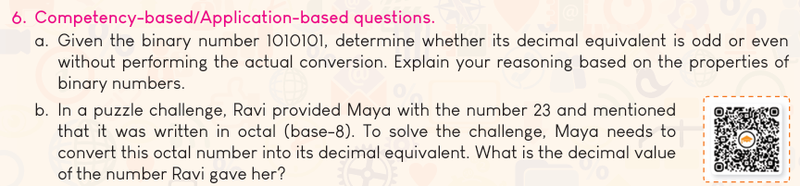
Aligned with NEP 2020 & NCF-SE 2023
Prayas (Application)

Slide 10
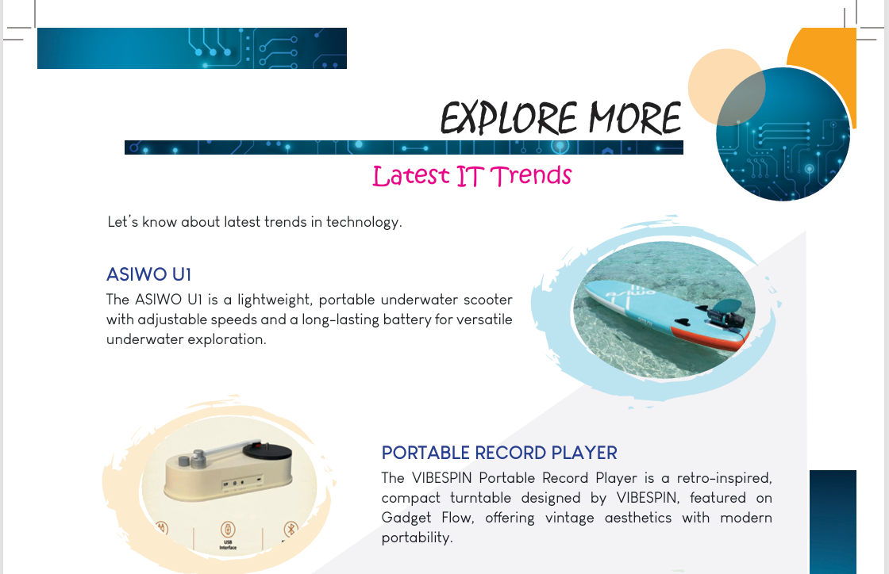
Aligned with NCF 2023
Prasar (Expansion)

Slide 11
Touchpad Plus V2.2 – Core Features
AI from Grade 1
CBQ
Custom Writing Space
QR on CBQ
HD Large Screenshots
Project Related Exercises

Slide 12
Touchpad Plus V2.2 - Elements
Let’s Plug-in
Let’s Catch Up
Tech Fact
Tech Hint
Factopedia
Tech Zone
Project Work
Periodic Assessment
Test Sheet
Practice Worksheets

Slide 13
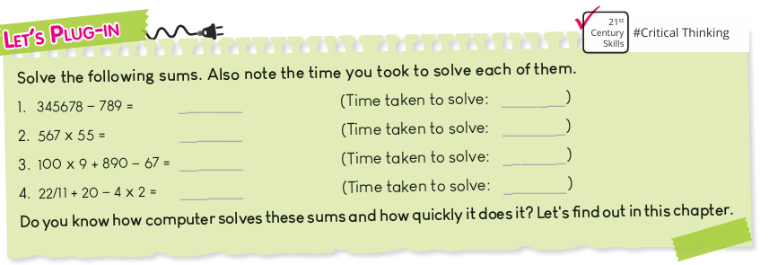
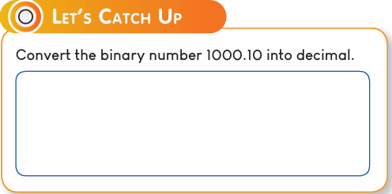
Touchpad Plus V2.2 - Elements
Let’s Plug In
Links back to previous knowledge before starting the lesson
Let’s Catch Up
Recalls a part of lesson quickly

Slide 14
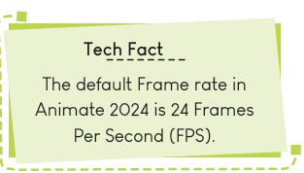
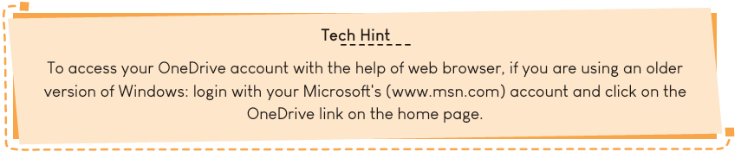
Touchpad Plus V2.2 - Elements
Tech Fact
Present a fact about the topic
Tech Hint
Shortcut key to perform an action

Slide 15
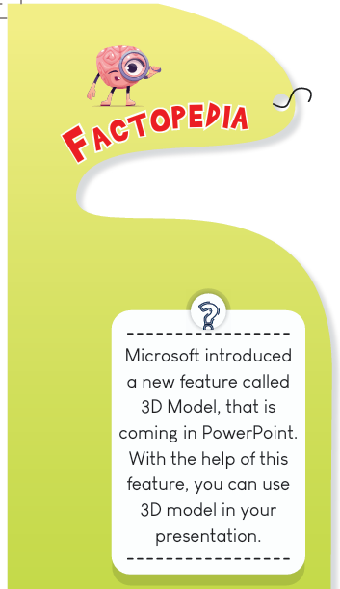

Touchpad Plus V2.2 - Elements
Factopedia
Some more interesting information
Tech Zone
Section such as Let’s Explore, Let’s Get Better & Let’s Solve

Slide 16
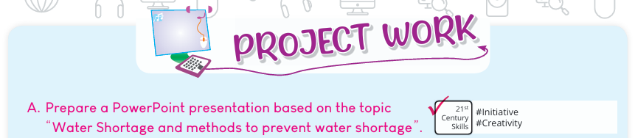
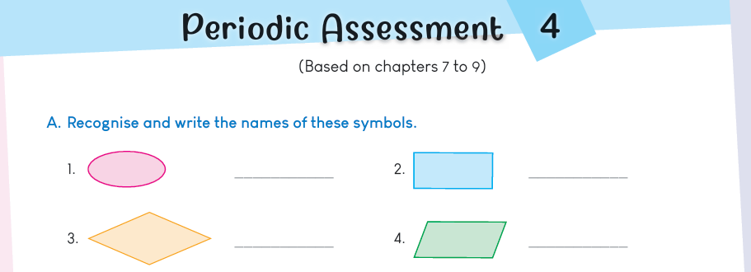
Touchpad Plus V2.2 - Elements
Project Work
Assessment to develop practical proficiency.
Periodic Assessment
& Test Sheets
4 Periodic Assessments and 2 Test Sheets.

Slide 17
Additional Features
Think Tank
Bridge Courses
SDG Activities
Capstone Project
Natural Facts
Supplements

Slide 18
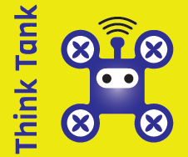
Think Tank
Introducing
Think Tank encourages students to explore innovative ideas and think beyond conventional topics.

Slide 19
Think Tank
If Krita brushes could paint with elements like fire, water and wind, what kind of scenes or characters would you create using these elemental brushes?

Slide 20
Think Tank
If your emails could be delivered by virtual birds that fly across the Internet. What kinds of birds would deliver different types of messages?

Slide 21
Think Tank
Imagine, you possess the power of jump statement, allowing you to leap to any part of the universe. Where would you jump to and what quests or missions would you undertake in each dimension?

Slide 22

SDG Activities
Introducing New Features
This section highlights how students can actively contribute to achieving all the 17 Sustainable Development Goals (SDGs) by leveraging digital literacy skills.

Slide 23
SDG Activity
SDG 6 : Clean water and sanitation While brushing many people leave the water running at the same time many people don't have easy access to clean water. Click a picture showing wastage of water and add a quote to spread awareness to save water among all in photo editor.

Slide 24
SDG Activity
SDG 15 : Life on Land Have children pretend they are forest animals and collect "litter" from the playground. Discuss how keeping our environment clean helps all living creatures. Create a Scratch project showing a clean playground with kids playing.

Slide 25

Natural Facts
Introducing New Features
Despite children living in a digital era, this section connects them to nature.

Slide 26
Natural Fact
Just like a rainbow has many colours, a computer screen uses red, green, and blue light to make all the colours we see, like mixing paints!

Slide 27
Natural Fact
Each zebra's stripe pattern is as unique as a human fingerprint or URL of a Website!

Slide 28
Natural Fact
The human eye is estimated at 576 megapixels with complex processing, while AI machine vision cameras can reach up to 100 megapixels.

Slide 29
Digital Support _{One-Stop Platform}
For Students and Teachers
Teacher’s Resources Interactive e-Book I Topic Animation I Software Download Link I Lesson Plans I Answer Keys I Homework Worksheets for SA I Smart Test Paper Generator I Learning Management System I Bridge Courses I Supplementary Material
Student Access
Interactive e-Book I Topic Animation I Software Download Link I Worksheets
Interactive e-Book
Chapter Voiceover I Animations I Interactive Exercises I Smart-board Tools I QR Codes
Full support Available in Android Mobile App also

Slide 30
New Features of Web Support
Supplements
Bridge Courses
New on WEB SUPPORT
Provides additional technical content for extended learning
This is to fill learning gaps of the students
Smart eBooks
Capstone Projects
HTML eBooks for on all OS and all Flipbooks
One Project for each Grade in all series

Slide 31
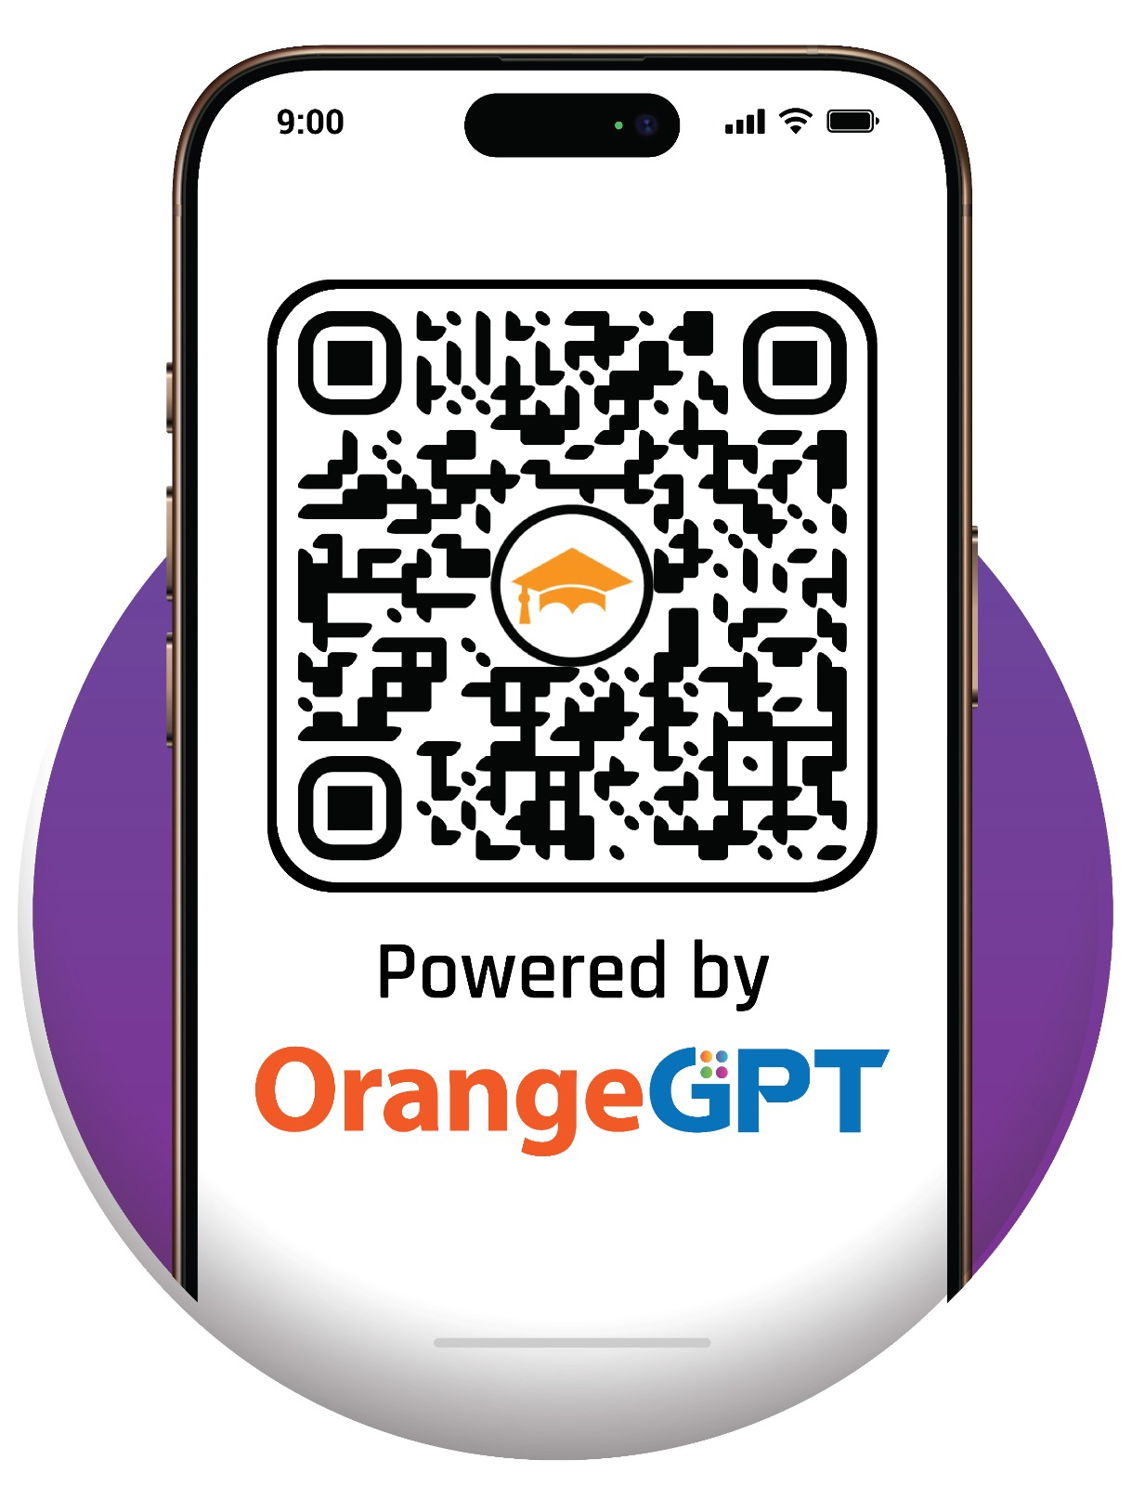
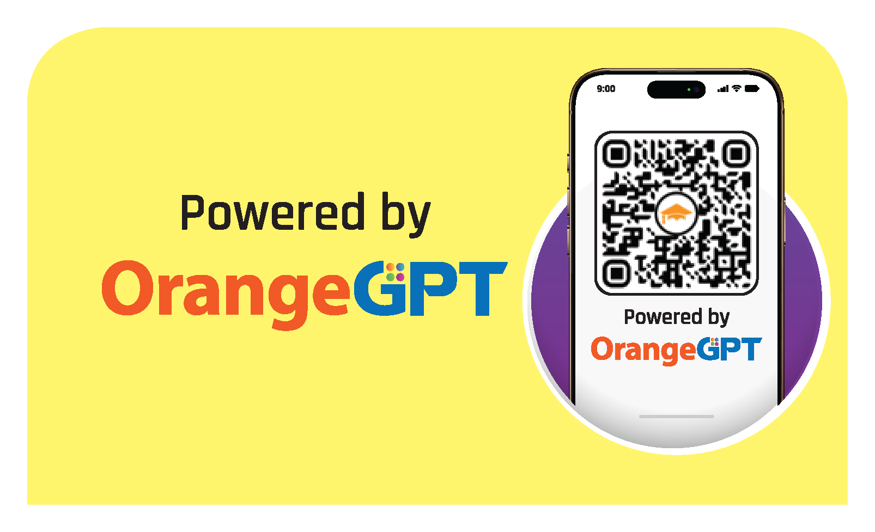
Introducing - 1st in the industry feature

Slide 32

"Let’s take a step together towards knowledge – for every step we take today builds a brighter tomorrow."
Orange Education

